Slide 1




Financial Metrics and Global Stock Market Analysis
Group 8

Slide 2
Introduction
This project explores how U.S. economic metrics (such as GDP, unemployment rate, consumer price index, federal funds rate, and consumer confidence index) impact the performance of major world stock exchanges. Using Python and the FRED API, we retrieve economic data and compare it with stock price data obtained via the Yahoo Finance API.

Slide 3



RQ1
RQ2
Do stock exchanges in developed countries show a stronger correlation with U.S. economic metrics than those in developing countries?
How does U.S. economic metrics influence the performance of U.S. stock exchanges compared to international stock exchanges?
Research Question & Hypotheses
H1
H2
The performance of U.S. stock exchanges is more sensitive to U.S. economic metrics than international stock exchanges.
Stock exchanges in developed countries show a stronger correlation with U.S. economic metrics compared to those in developing countries

Slide 4
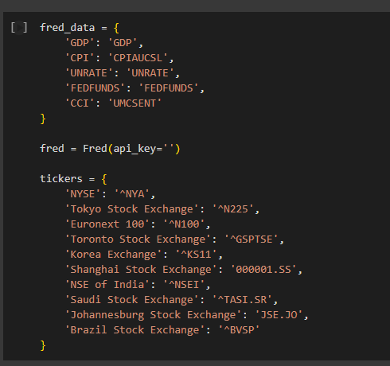
Data Retrieving
Data was retrieved from 2 APIs:
FRED (Federal Reserve Economic Data).
Yahoo Finance/Y-Finance

Slide 5
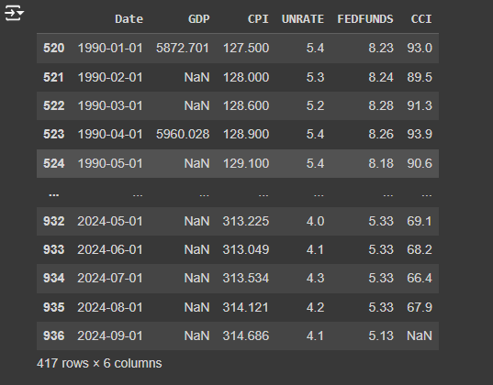
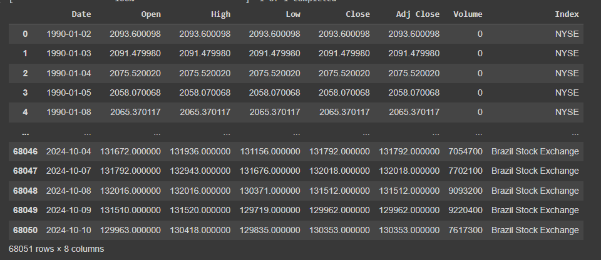
Retrieving Economic Parameters & Stock Data

Slide 6
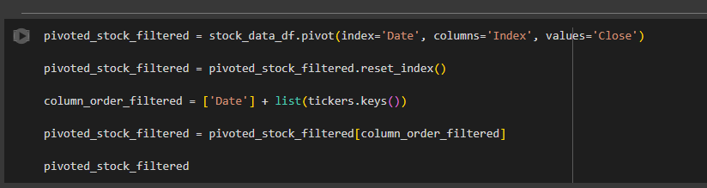
Data Cleaning
For each index, only “Close” prices are extracted.

Slide 7

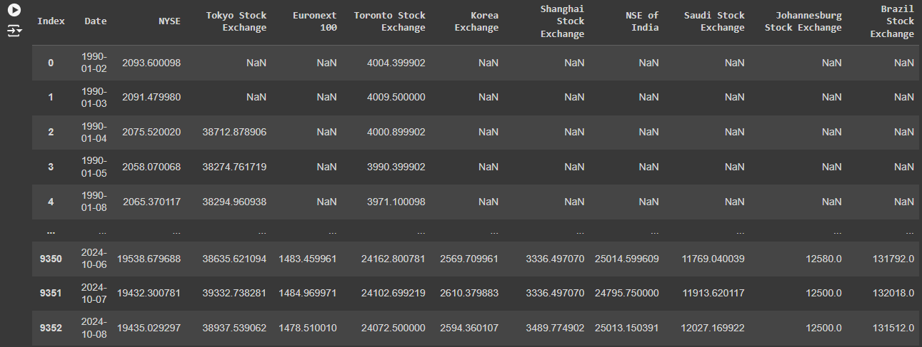
Filling Missing Values with Forward Fill

Slide 8
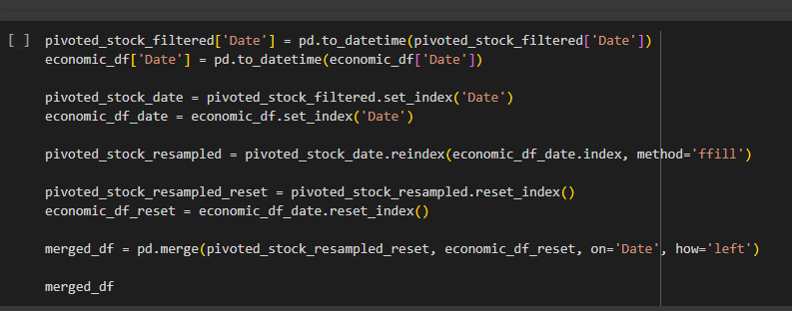
(Data is merged by date.)

Slide 9
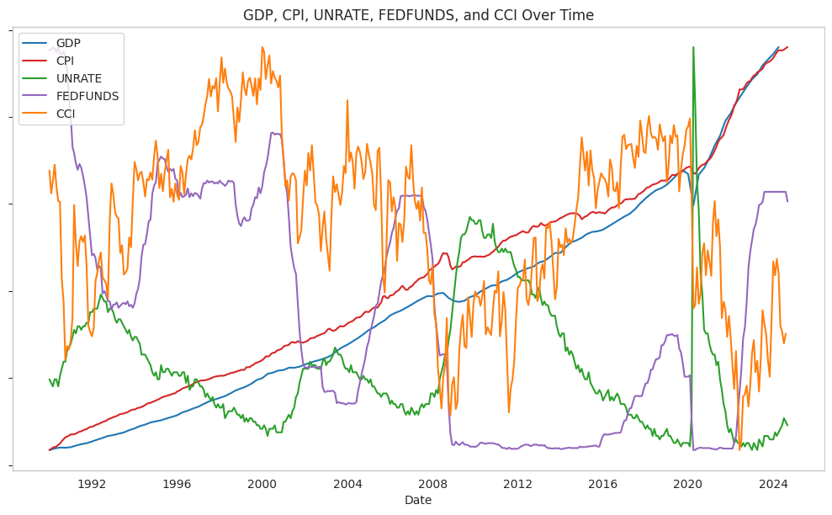
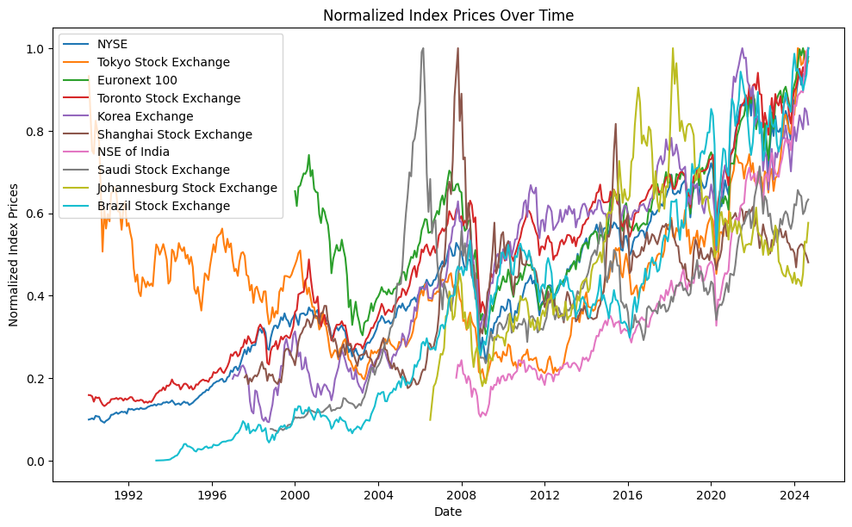
GDP, CPI, UNRATE, FEDFUNDS, and CCI & Stock Index Prices Over Time

Slide 10
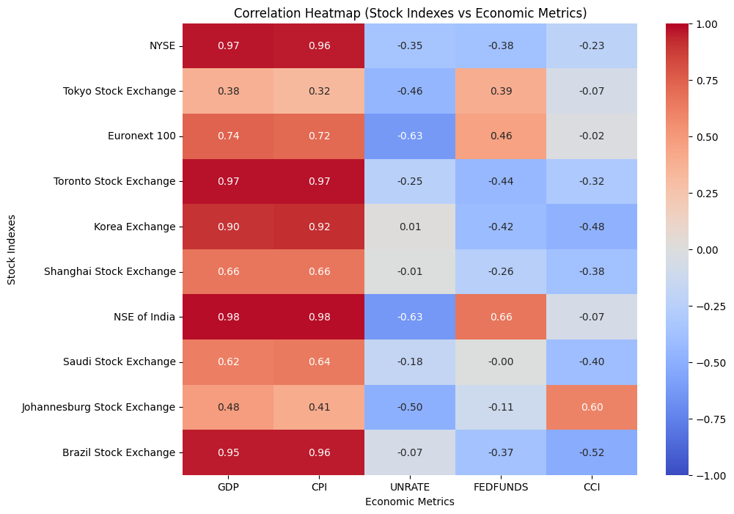
Regular Correlation
NYSE, Toronto Stock Exchange, and NSE of India have strong positive correlations with U.S. economic metrics like GDP and CPI, indicating these exchanges are more influenced by these factors.
In contrast, the Unemployment Rate (UNRATE) and Consumer Confidence Index (CCI) tend to have negative correlations with most stock indexes.
Notably, Tokyo Stock Exchange has weaker correlations across the board, while Johannesburg Stock Exchange and Saudi Stock Exchange display mixed correlations with U.S. economic metrics.

Slide 11
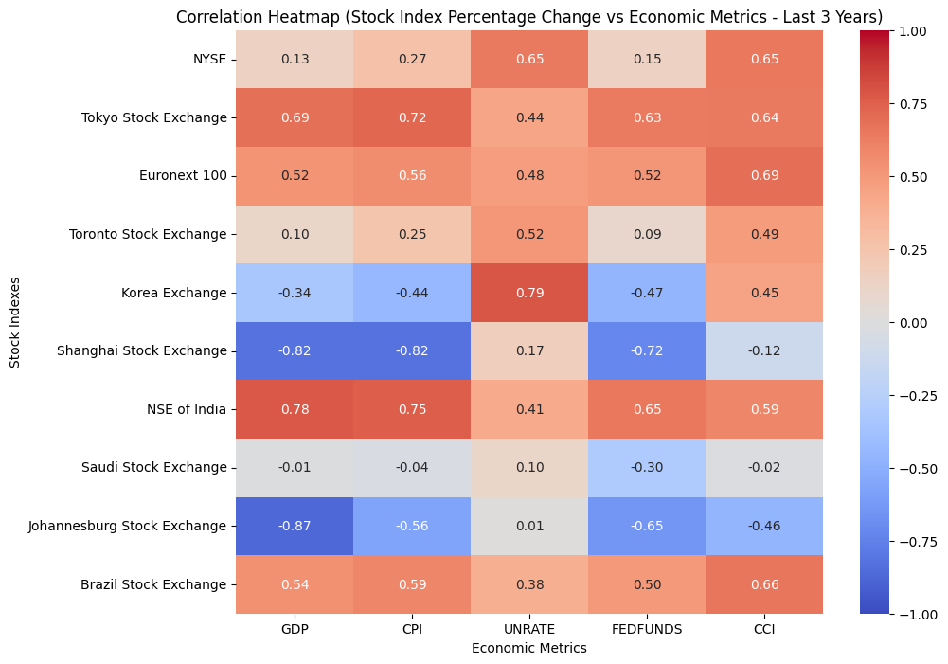
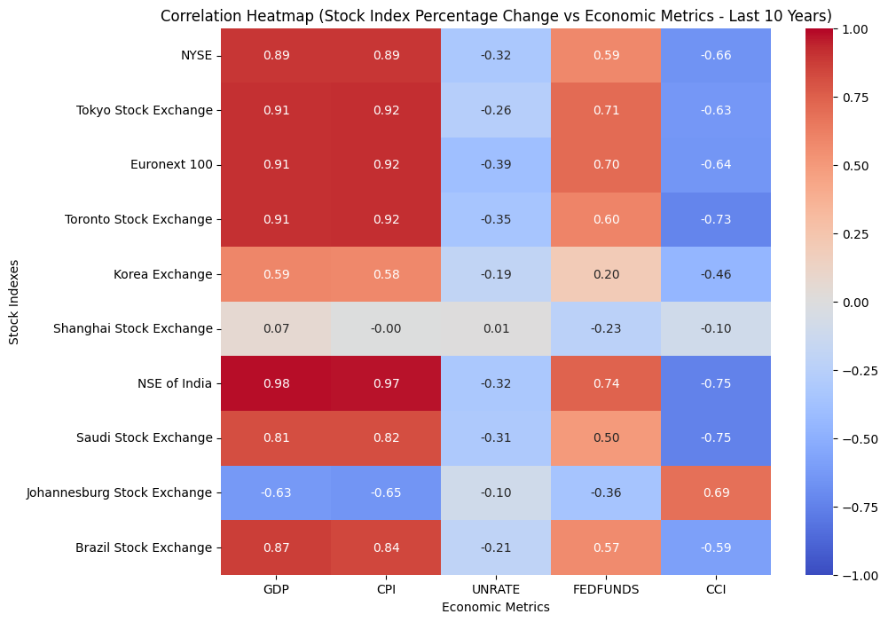
3 years
Period Correlation (3 Years & 10 Years)
01.
10 years

Slide 12
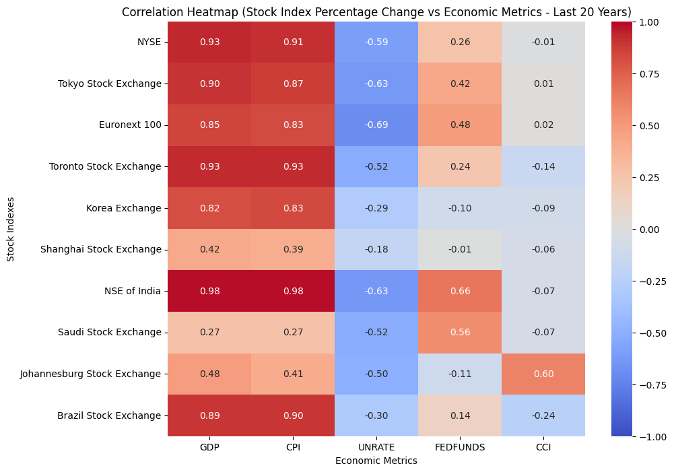
3 years
Period Correlation (20 Years)
10 years

Slide 13
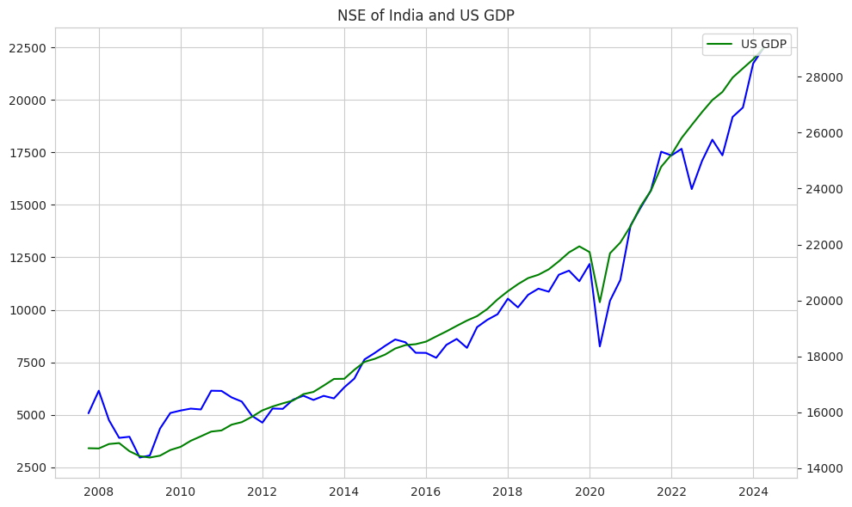
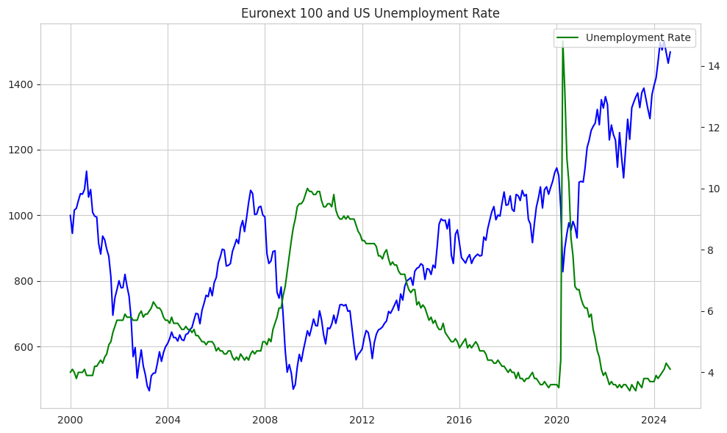
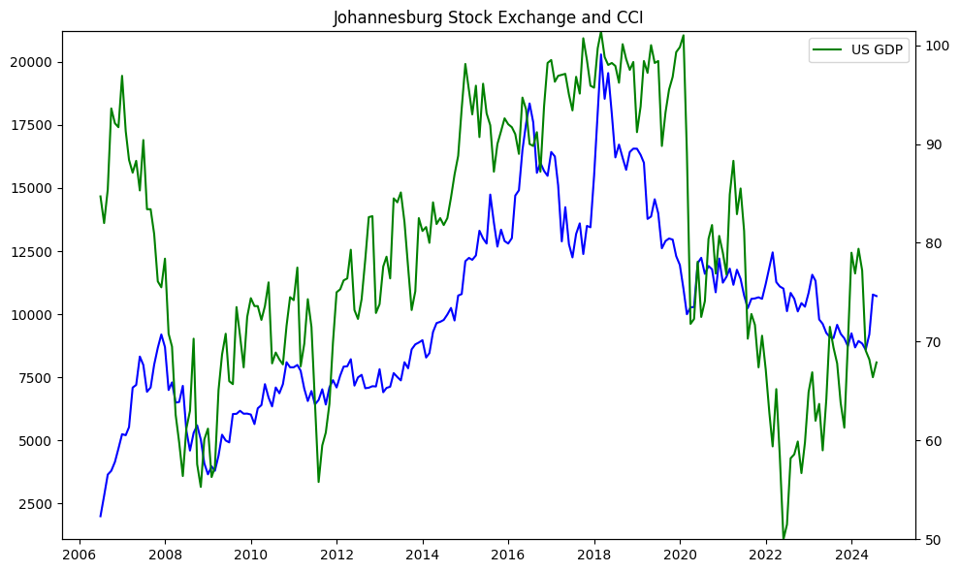
3 years
10 years

Slide 14
Hypothesis I
Null Hypothesis (H0): There is no significant difference between the correlation strength (R2 values) of the NYSE and international stock exchanges with U.S. economic metrics.
Alternative Hypothesis (H1): There is a significant difference between the correlation strength (R2 values) of the NYSE and international stock exchanges with U.S. economic metrics.

Slide 15
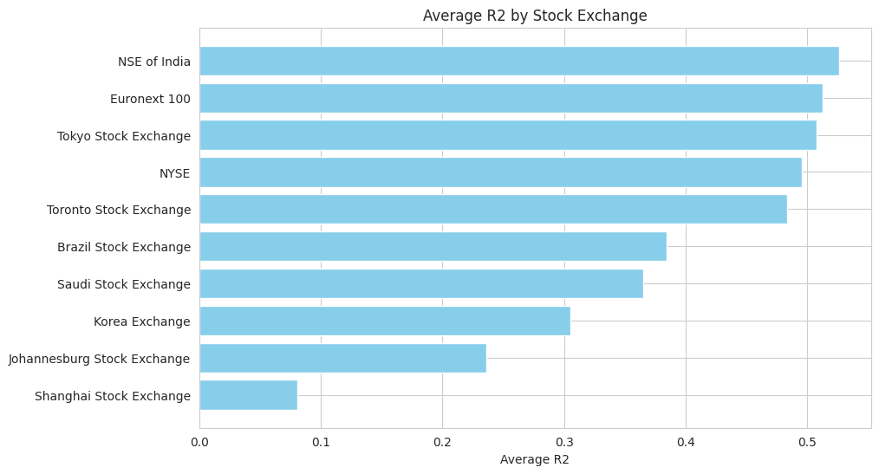
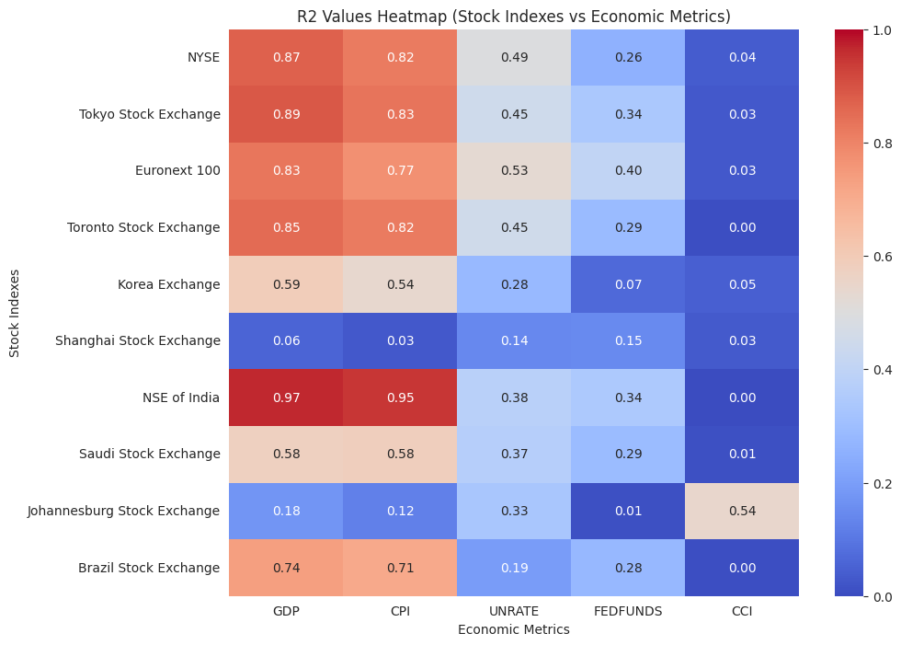
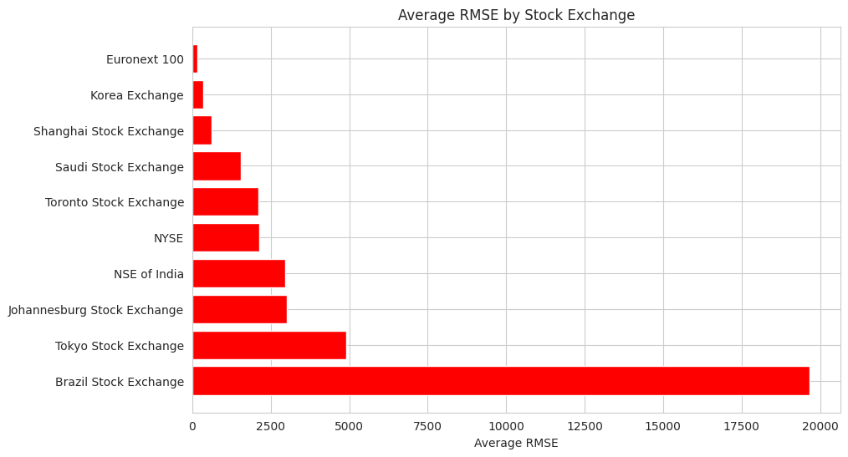
Hypothesis I

Slide 16
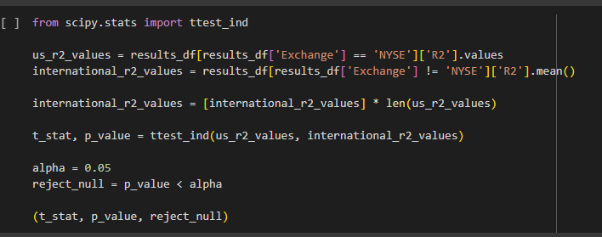
Hypothesis I
The t-test results show a t-statistic of approximately 0.734 and a p-value of approximately 0.484.
Since the p-value is greater than the significance level (alpha) of 0.05, we fail to reject the null hypothesis.
This means there is no statistically significant difference between the sensitivity of U.S. stock exchanges and international stock exchanges to U.S. economic metrics .

Slide 17
Hypothesis II
Null Hypothesis (H0): Stock exchanges in developed countries have no or non-significant correlation with U.S. economic metrics compared to those in developing countries.
Alternative Hypothesis (H1): Stock exchanges in developed countries show a stronger correlation with U.S. economic metrics compared to those in developing countries

Slide 18
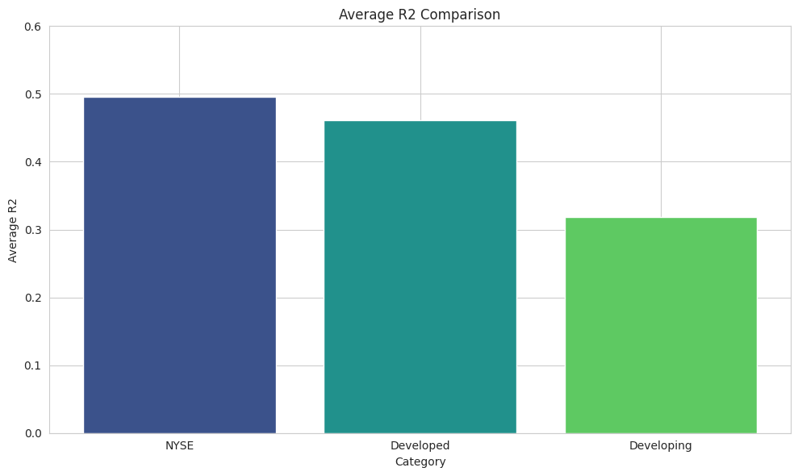
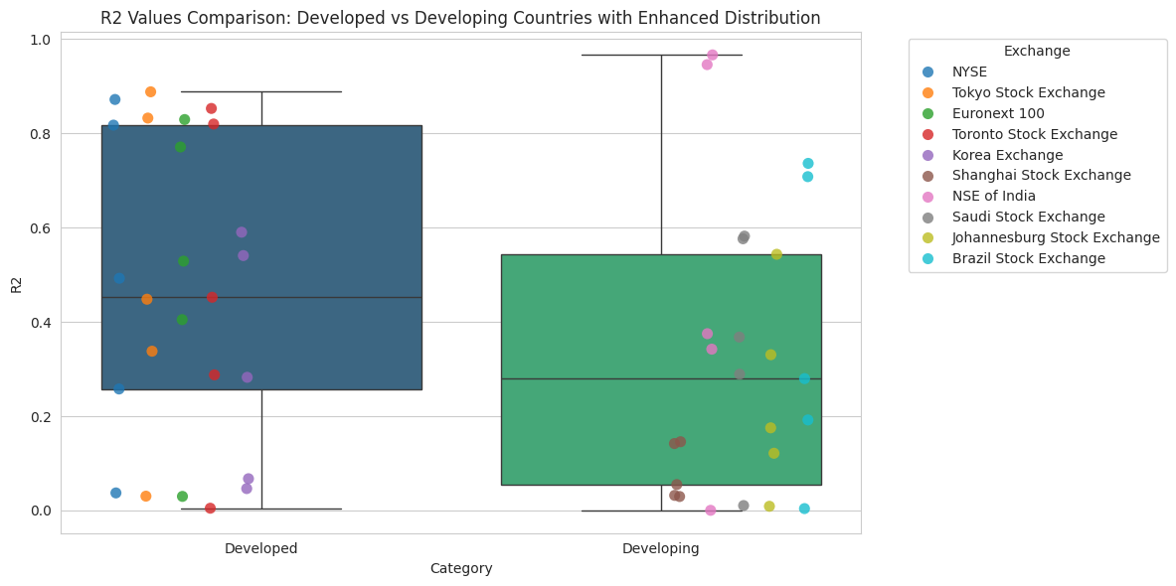
Hypothesis II

Slide 19
Hypothesis II
Stock exchanges in developed countries (like NYSE and Tokyo Stock Exchange) tend to have higher and more consistent R2 values, meaning they are more closely related to U.S. economic factors. In contrast, exchanges in developing countries have a wider range of R2 values, showing more variation in their connection to U.S. metrics.

Slide 20
Thank you very much!

